Slide 1
Bootstrap JavaScript Components

Slide 2
Objectives
Recognize how the JavaScript components provide dynamic behavior to your website
Create various navigational elements in your website using Tabs and Accordion
Create modals, tooltips and popovers to reveal content in your website
Build a carousel to show dynamic content on your website

Slide 3
Bootstrap and JavaScript

Slide 4
Bootstrap and JavaScript
Bootstrap’s JavaScript support is through JS Plugins
Plugins written based on Jquery
Plugins can be individually included

Slide 5
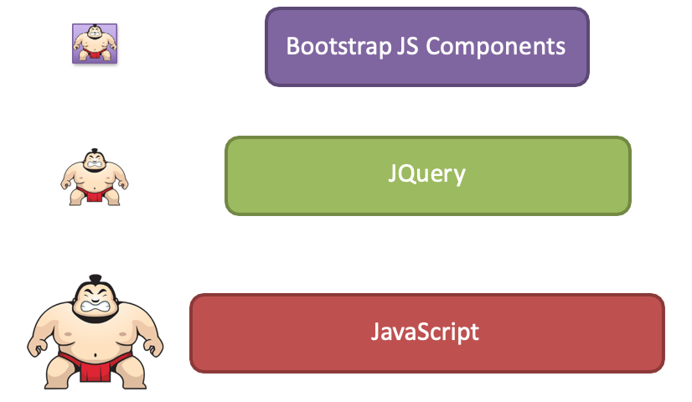
Bootstrap and JavaScript

Slide 6
Bootstrap JS Components
JS components can all be used without writing a single line of JavaScript:
data-* attributes (e.g., data-toggle, data-spy)
Straightforward approach to use plugins
We will explore this approach in this module
Full JS API available if needed
Need to know JQuery syntax and JavaScript

Slide 7
Tabs, Pills and Tabbed Navigation

Slide 8
Tabs, Pills
Navigation elements for navigating content within a page that is organized into multiple panes

Slide 9
Exercise 14: Tabs
Design a web page to use tabbed navigation for organizing the content
Use tab panes and organize the content into the panes
Facilitate navigation among the tab panes using the tabbed navigation elements

Slide 10
Collapse and Accordion

Slide 11
The Collapse Plugin
Collapse plugin provides a quick way of revealing and hiding content.
Toggling of content requires the use of a button or a link to trigger the toggle

Slide 12
Exercise 15: Accordion
Design an accordion using the collapse plugin together with the card component

Slide 13
Tooltips, Popovers and Modals

Slide 14
Tooltips, Popovers and Modals
Revealing content upon interacting with an element on the web page
Information displayed as an overlay
Order of flexibility:
Tooltip → Popover → Modal

Slide 15
Modal
More detailed information can be presented than tooltips and popovers
Modal contains header, body and footer
Can use the Bootstrap grid in the body to organize content

Slide 16
Exercise 16: Tooltips and Modals
Add tooltips to a web page
Add modals that are revealed when the user clicks on a link or a button in the web page.

Slide 17
Carousel

Slide 18
Carousel
An interesting component that allows the inclusion of a slideshow with captions
Manual controls for the carousel

Slide 19
Exercise 17: Carousel
Use a carousel component in your web page
Configure various aspects of the carousel
Add controls to the carousel to manually control it

Slide 20
Summary
Understand recognize how the JavaScript components provide dynamic behavior to your website
Create various navigational elements in your website using Tabs and Accordion
Create modals, tooltips and popovers to reveal content in your website
Build a carousel to show dynamic content on your website

